Slide 1

Portfolio Milestone Project
Kobi Wiseman
The School of Information Studies
Syracuse University
April 2021

Slide 2

The Program’s Learning Goals
1
Description of the Major Practice Areas in Data Science
2
Collecting and Organizing Data
3
Identifying Patterns in Data via Visualization, Statistical Analysis, and Data Mining
4
Developing Alternative Strategies Based on the Data
5
Developing a Plan of Action to Implement the Business Decisions Derived from the Analysis
6
Demonstrating Communication Skills Regarding Data and Its Analysis for Managers, IT Professionals, Programmers, Statisticians, And Other Relevant Professionals in Their Organization
7
Synthesizing the Ethical Dimensions of Data Science Practice
Portfolio Milestone Project

Slide 3
Final Projects overview
Four final projects were selected to demonstrate the achievement of program learning goals:
IST687 – Introduction to Data Science
IST707 – Data Analytics
IST652 – Scripting for Data Analysis
IST718 – Big Data Analytics
Portfolio Milestone Project

Slide 4

IST687 – Introduction to Data Science
Prof. Jeffrey Saltz, Fall 2019
Airlines Customer Experience:
Included information about airlines passengers’ customer experience.
The features were consisted of both a passenger’s details (age, gender, and airline membership information) and that passenger’s related flight details (origin, destination, delay in departure, delay at arrival).
The goal for these two projects is to predict what factors shall increase the passengers’ tendency to become more ‘promoter’ and less ‘neutral’ and ‘detractors’ (these statuses are a function of the Net Promoter Score).
Group Project
R Studio was used
Portfolio Milestone Project

Slide 5
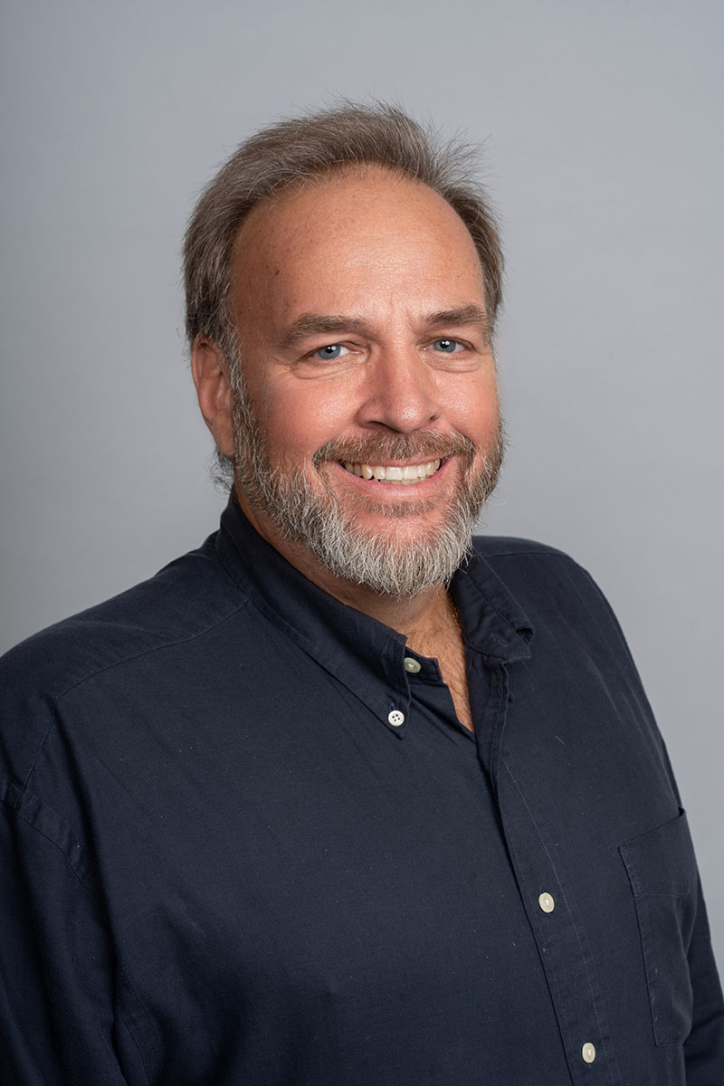
IST707 – Data Analytics
Prof. Stephen Wallace, Spring 2020
Airlines Customer Experience:
Included information about airlines passengers’ customer experience.
The features were consisted of both a passenger’s details (age, gender, and airline membership information) and that passenger’s related flight details (origin, destination, delay in departure, delay at arrival).
The goal for these two projects is to predict what factors shall increase the passengers’ tendency to become more ‘promoter’ and less ‘neutral’ and ‘detractors’ (these statuses are a function of the Net Promoter Score).
Group Project
Orange was used
Portfolio Milestone Project

Slide 6
IST652 – Scripting for Data Analysis
Prof. Ying Lin, Summer 2020
Classic Video Games Sales:
The features in the data included information about each game itself (game type, genre, and distribution year) and its revenues, divided by areas in the world (US, Japan, Europe, and others).
Conducted both supervised model for finding the most influential factors for determining a game’s revenues, and unsupervised model to identify different patterns among those video games.
Individual Project
Python was used
Portfolio Milestone Project

Slide 7

IST718 – Big Data Analytics
Prof. Willard E. Williamson, Fall 2020
Used Vehicles Buying:
The data file included many features regarding the vehicles’ characteristics (manufacturer, car type, engine, fuel consumption, gear type etc.) and the listing itself (posting date, number of previous owners and offered price). Using various models, we were able to predict listing price and number of days to remain on the market with supervised models, as well as identifying patterns within the listings using unsupervised models.
Group Project
PySpark was used
Portfolio Milestone Project

Slide 8
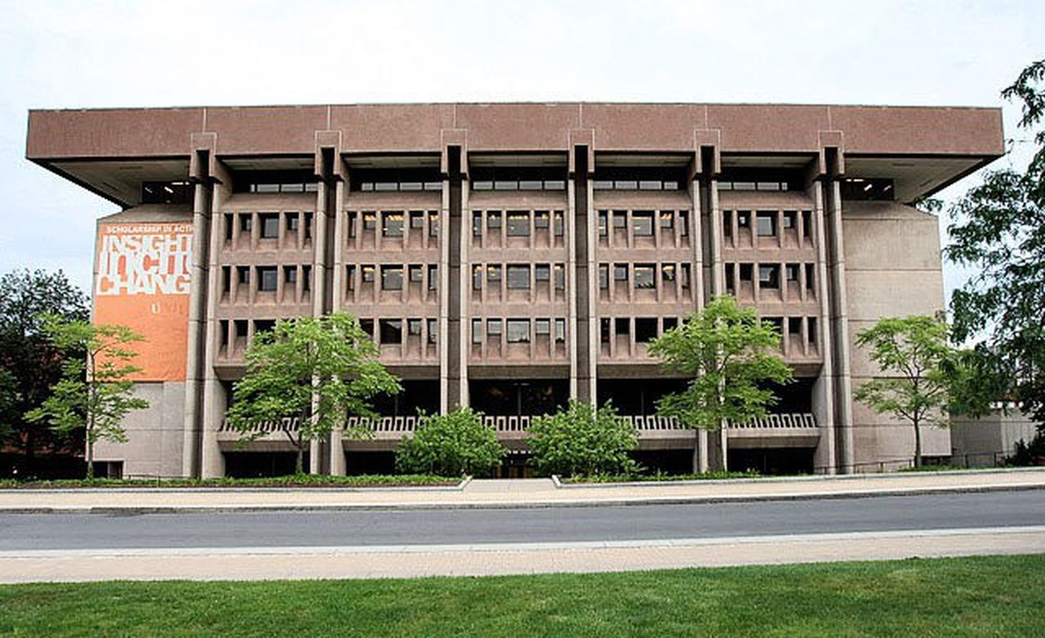





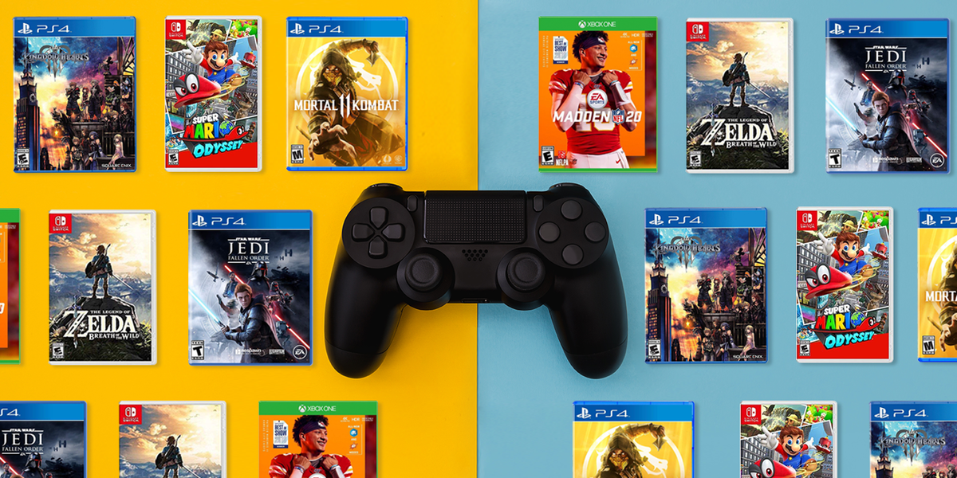
Description of the Major Practice Areas in Data Science
Portfolio Milestone Project

Slide 9
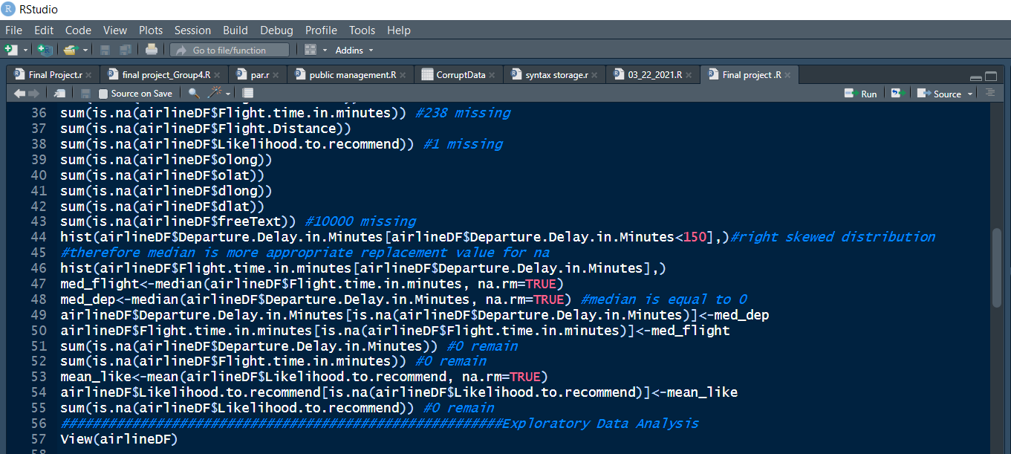
Collecting and Organizing Data
Portfolio Milestone Project

Slide 10
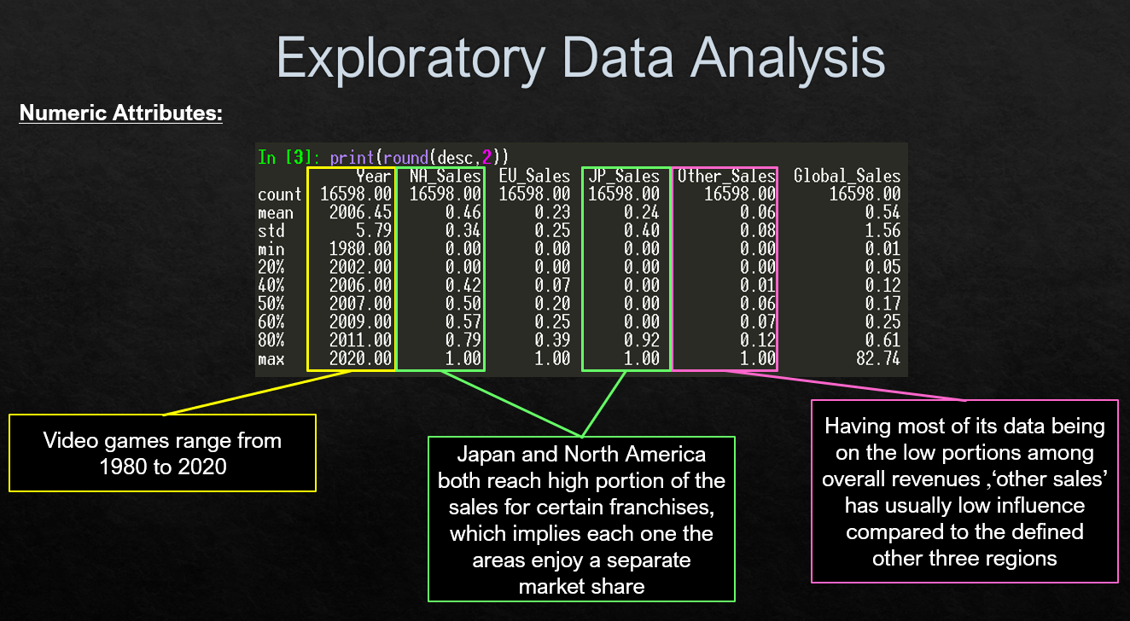
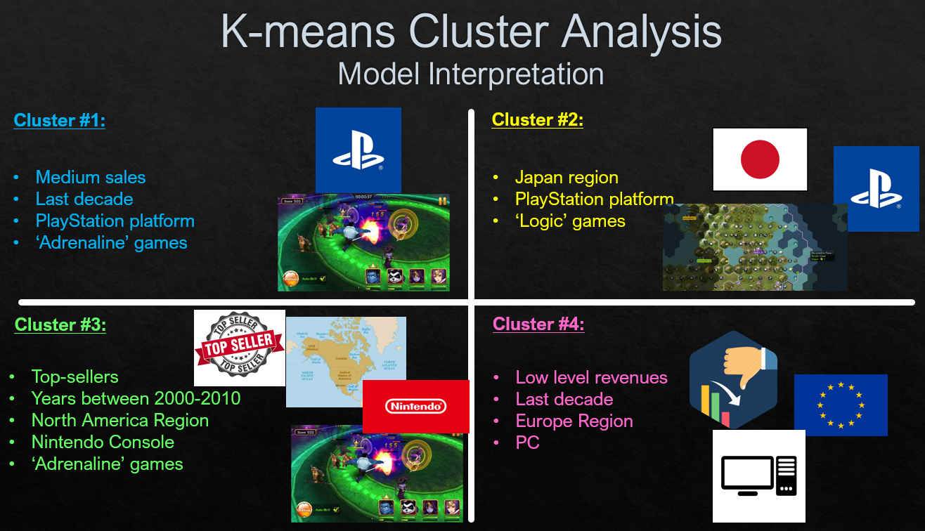
Identifying Patterns in Data via Visualization, Statistical Analysis, and Data Mining
Portfolio Milestone Project

Slide 11
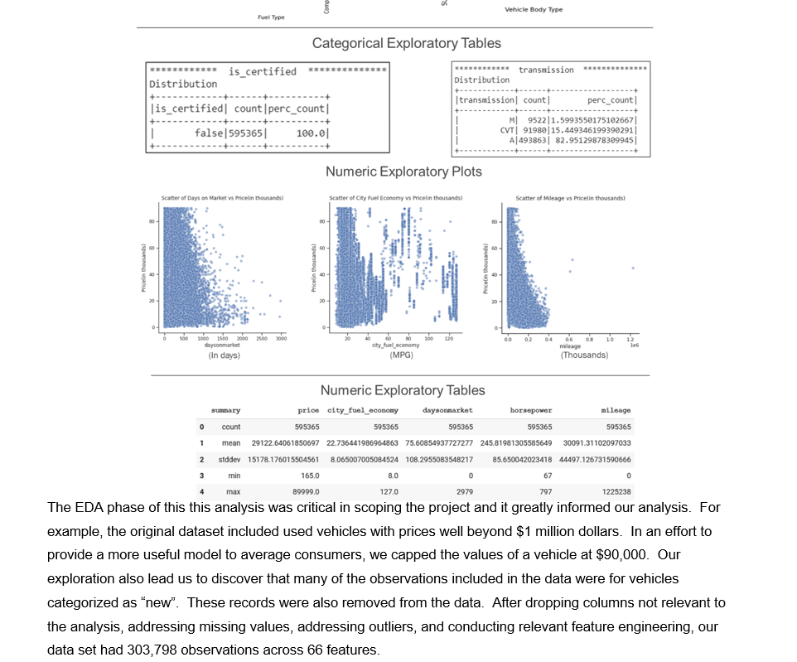
Developing Alternative Strategies Based on the Data
Portfolio Milestone Project

Slide 12
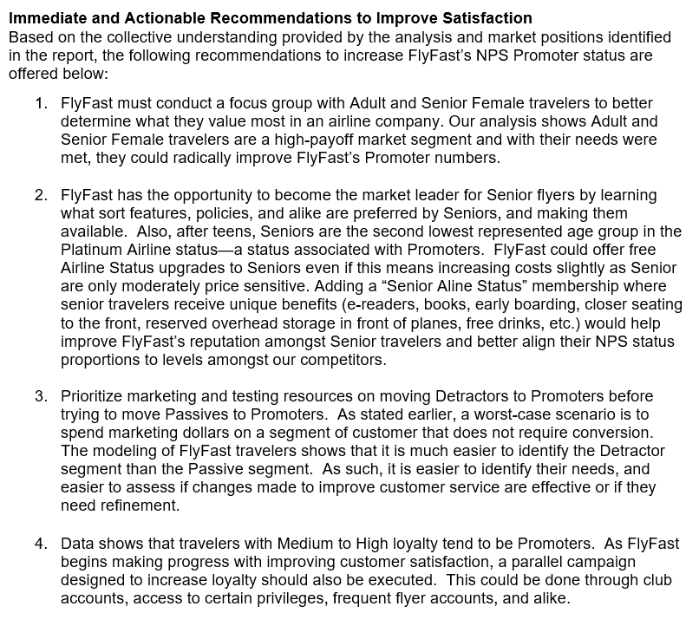
Developing a Plan of Action to Implement the Business Decisions Derived from the Analysis
Portfolio Milestone Project

Slide 13
Demonstrating Communication Skills Regarding Data and Its Analysis for Managers, IT Professionals, Programmers, Statisticians, And Other Relevant Professionals in Their Organization
Watch my YouTube video:
https://youtu.be/hu9kg7d4ya0
Portfolio Milestone Project

Slide 14
Synthesizing the Ethical Dimensions of Data Science Practice
User_ID | First_Name | Last_Name | Gender | Age | … | …
 |  |  | F | 16
 |  |  | F | 19
 |  |  | M | 24
 |  |  | M | 19
 |  |  | F | 42
 |  |  | M | 25
 |  |  | F | 33
Portfolio Milestone Project

Slide 15
Thank you!
(Maybe see you again in my PhD…?)

